Slide 1
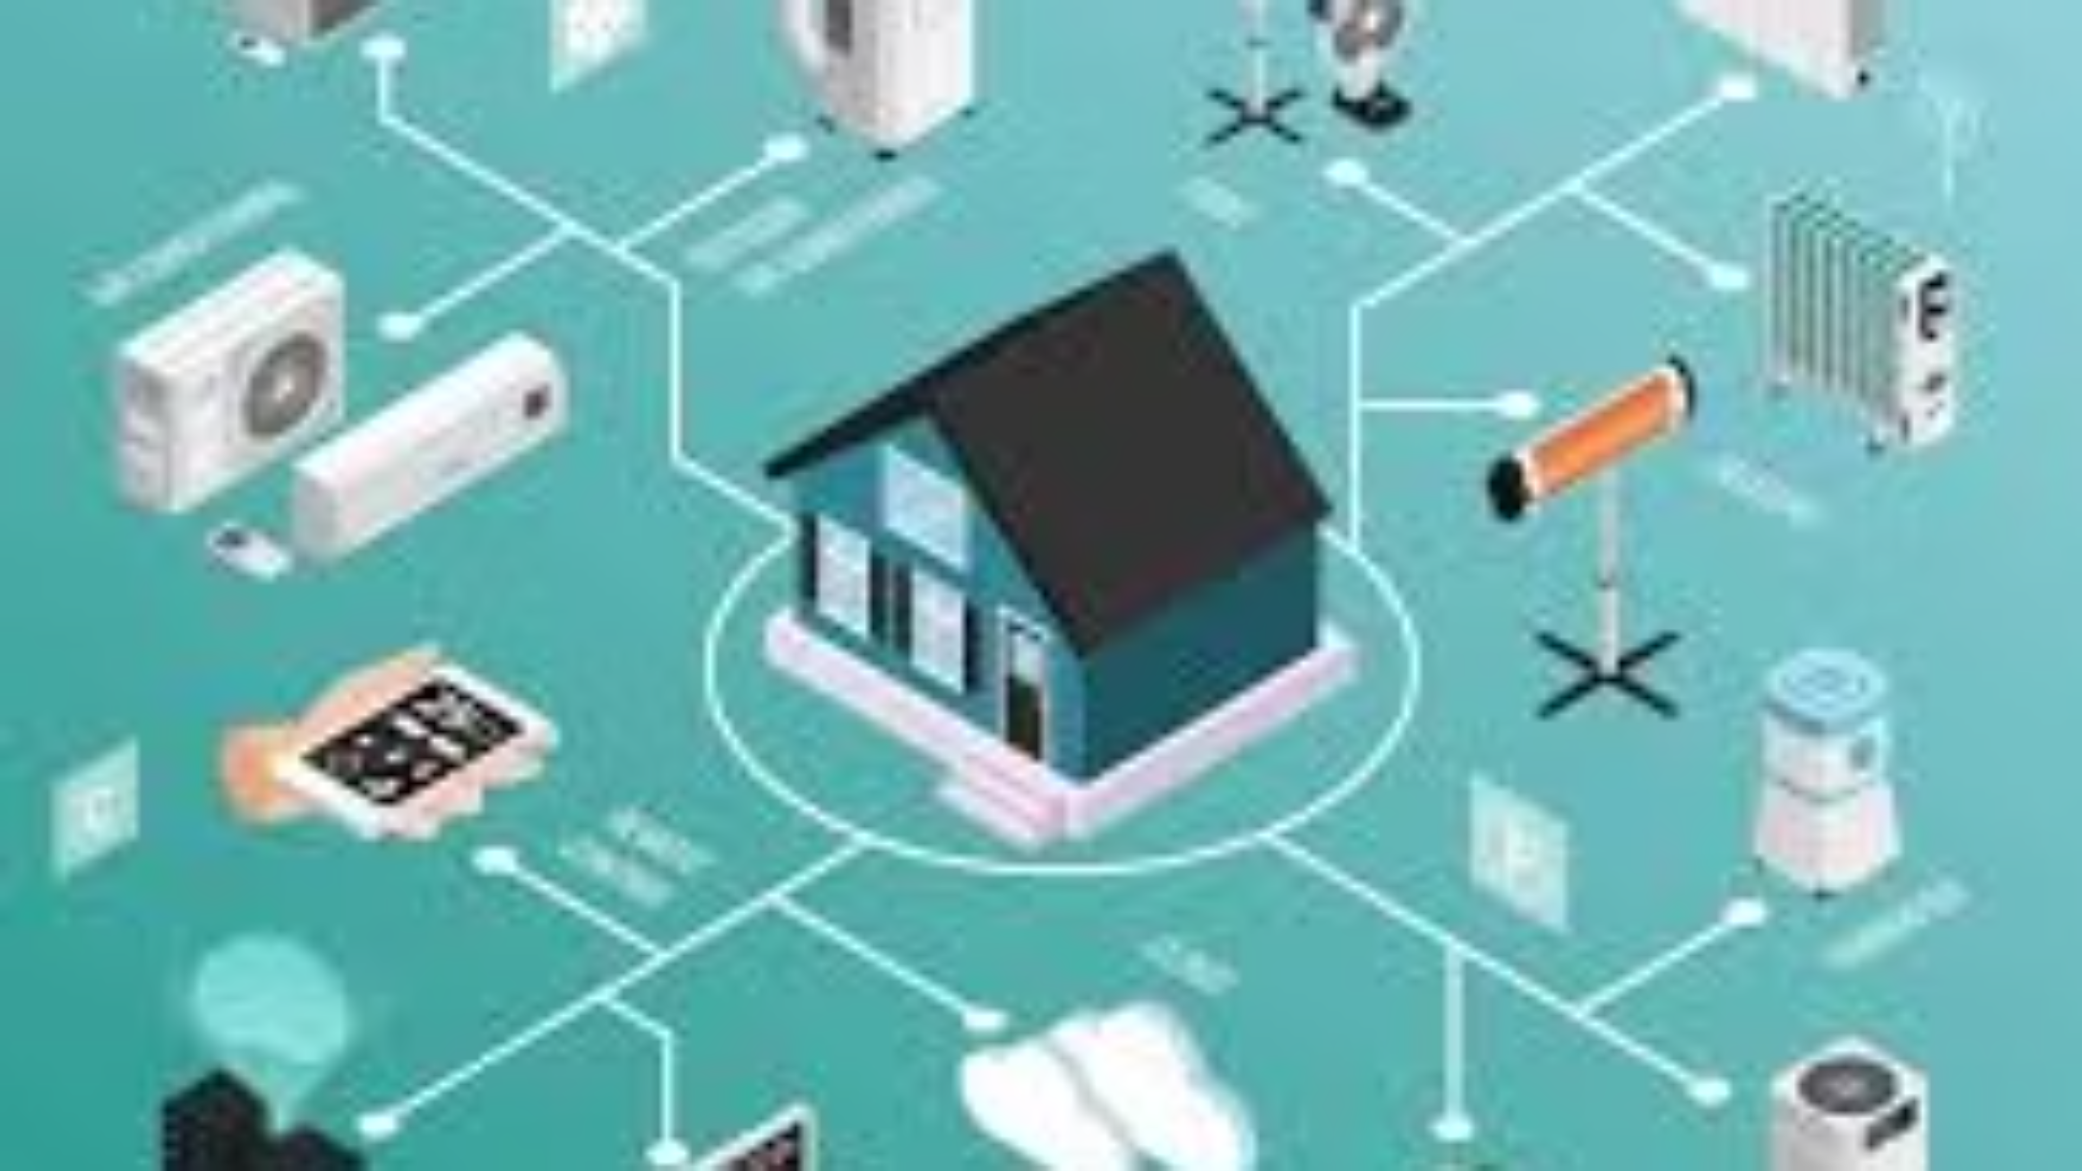

Smart Home Energy Management System
Module 2: Device Management
S. No | Team Members
1 | Fahim Shaik
2 | Bharathi Selvaraj
3 | Vaishnavi M
4 | Jiya Kazi
5 | Jiya Jain
Under the Guidance of
Ms. T. Premalatha

Slide 2
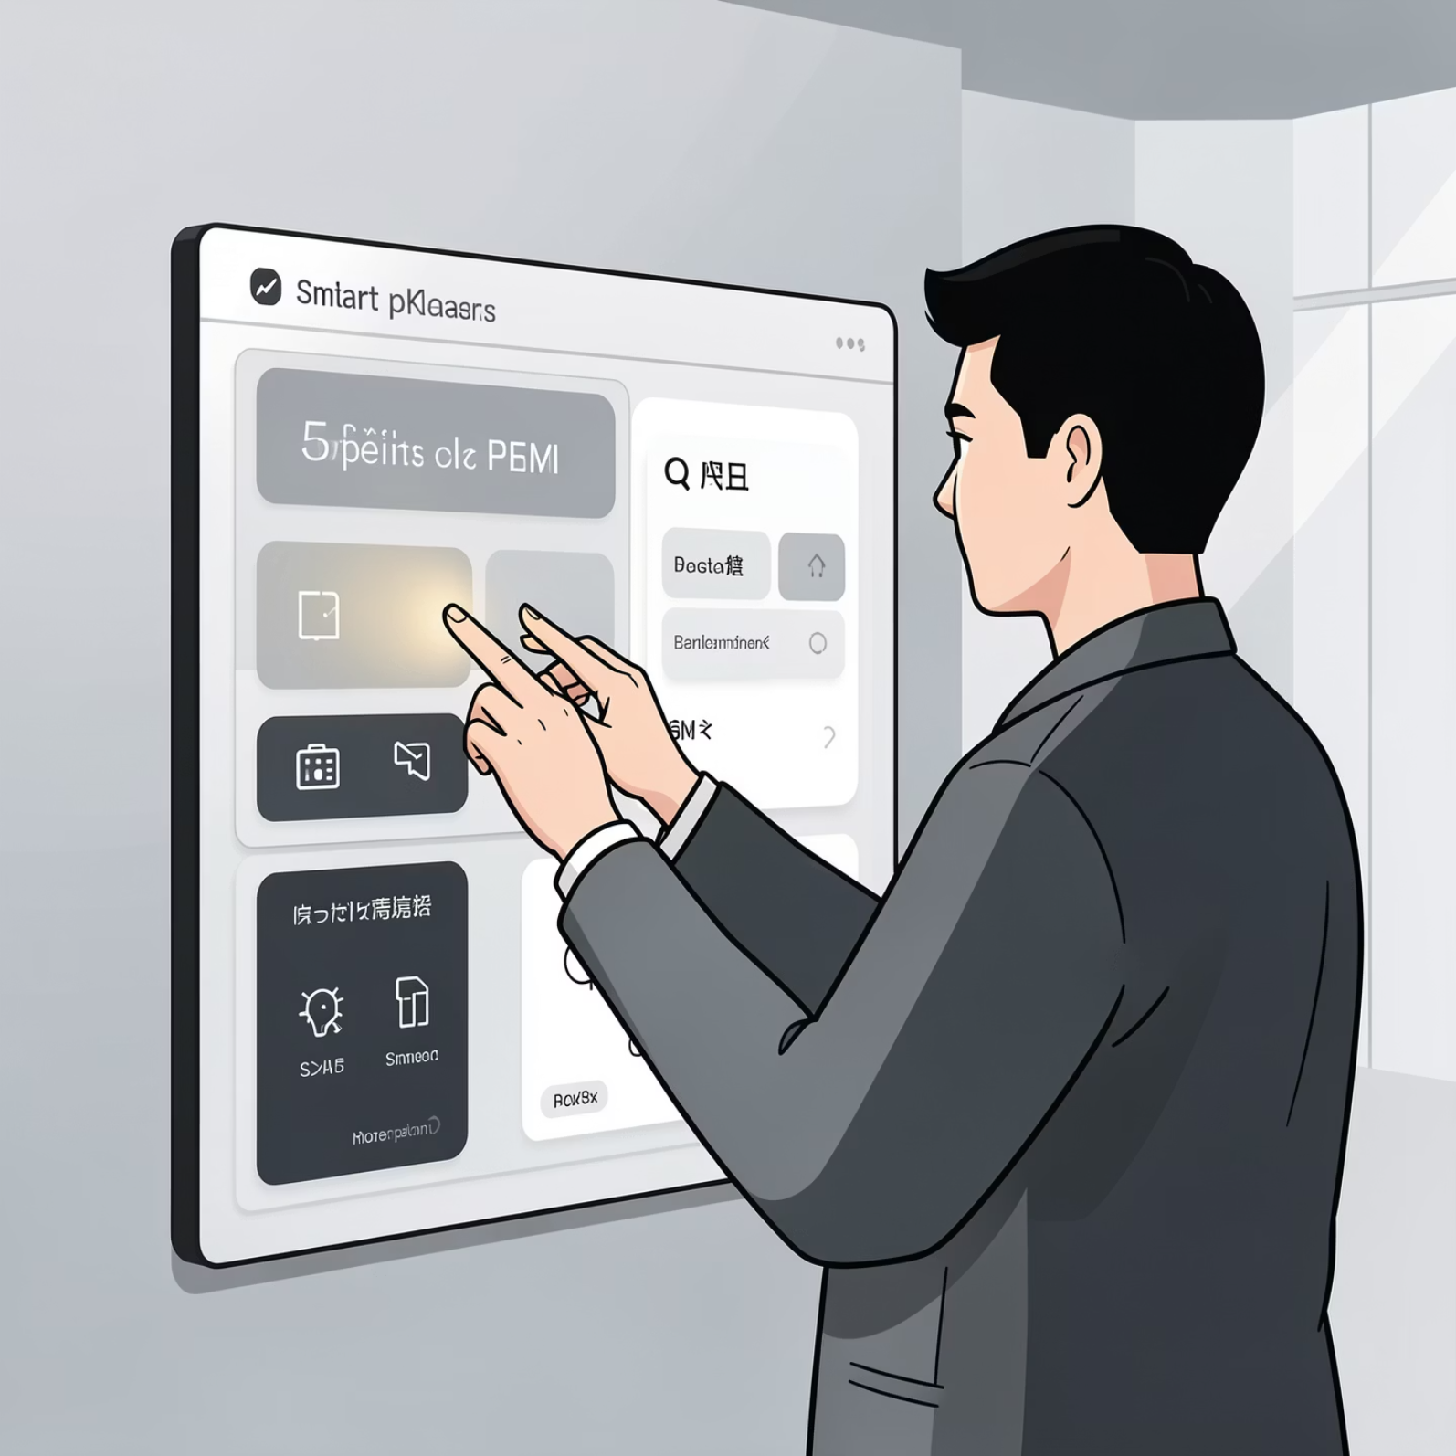

SHEMS: The Core Functional Module
After login, users can efficiently manage their devices:
View registered devices
Turn devices ON or OFF as needed.
Remove unwanted devices from their system.
Administrators have full control to monitor and manage all devices in the system.

Slide 3
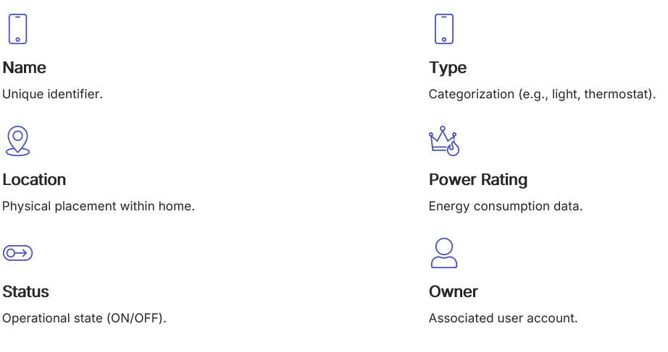

Core Concept of Device Management

Slide 4

Device Ownership Logic
One User → Many Devices
This foundational principle ensures that each user has exclusive control over their registered smart devices, upholding privacy and operational integrity.
✔ Users see only their devices
✔ Users cannot access others’ devices
✔ Admin can access all devices

Slide 5
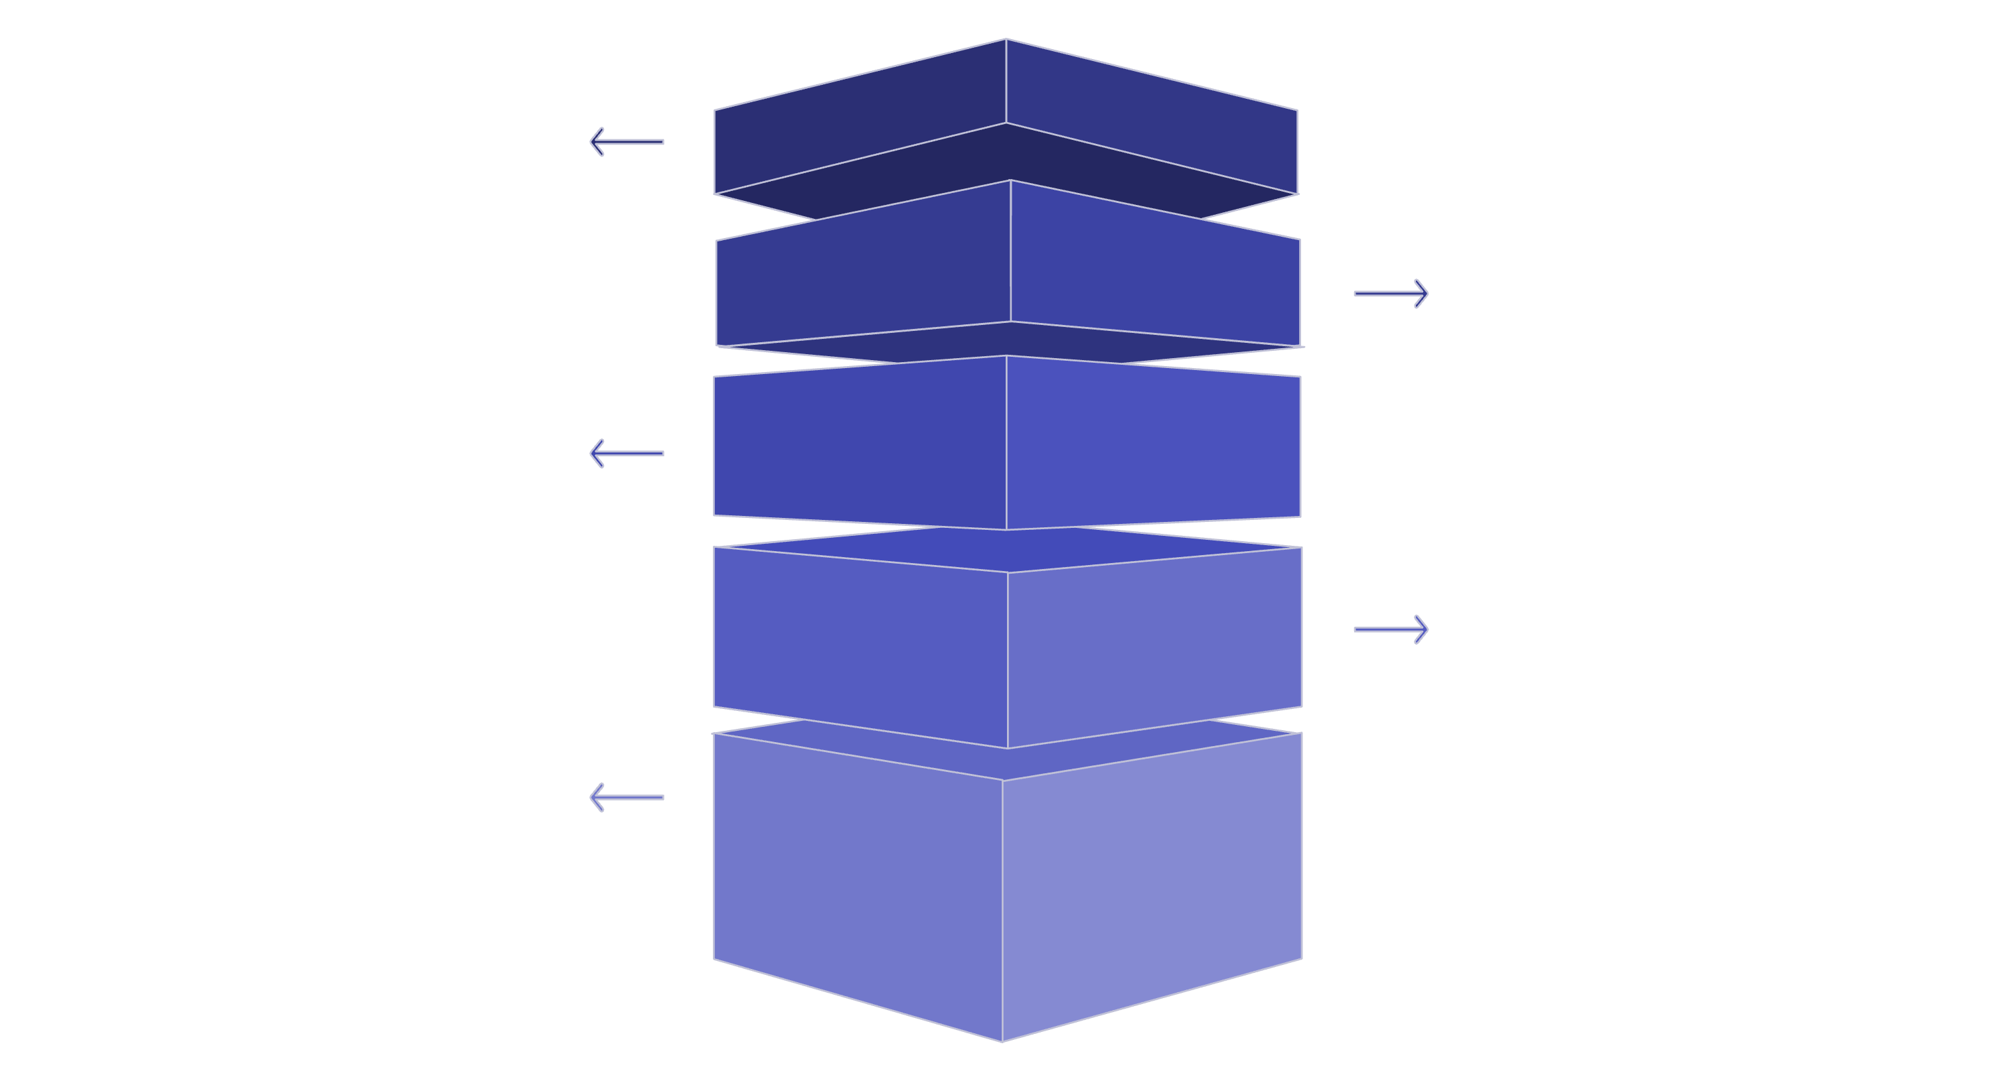

Architecture: MVC Pattern
View Layer
UI dashboards and device pages for user interaction.
Controller Layer
Handles user input and routes requests to services.
Service Layer
Implements business logic and orchestration.
Repository Layer
Manages data access and persistence operations.
Model Layer
Defines domain entities and data structures.

Slide 6

Operational Flow: A Layered Approach
01
02
03
Presentation Layer (UI)
Controller Layer
Service Layer
User interface elements like forms, dashboards, and interactive buttons.
Interprets and handles all incoming user requests.
Encompasses the core business logic and critical security checks.
04
05
Repository Layer
Database Layer
Manages all interactions and operations with the database.
Houses the central 'Device' table, storing all device information.

Slide 7
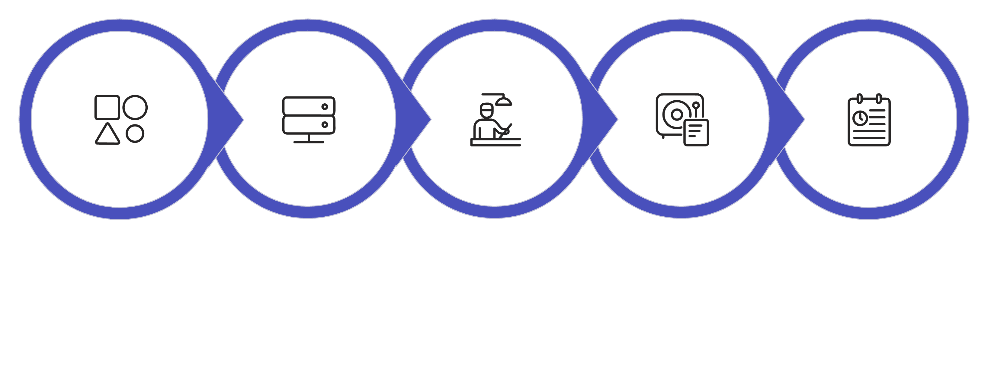





Adding a New Smart Device
The process of adding a new device is simple and secure, connecting user input with backend logic and database storage.
User Form
Controller
Service
Database
Dashboard

Slide 8


Viewing Personal Devices
Accessing personal devices is a straightforward process that leverages secure user-specific data retrieval. Each user is presented with a dashboard tailored to their owned devices.
User initiates a request from their dashboard.
The Service layer queries for devices.
Uses findByUser(user) to filter results.
Only devices owned by the logged-in user are displayed.
🔒 Devices are rigorously filtered by ownership, ensuring data privacy and preventing unauthorised access.

Slide 9
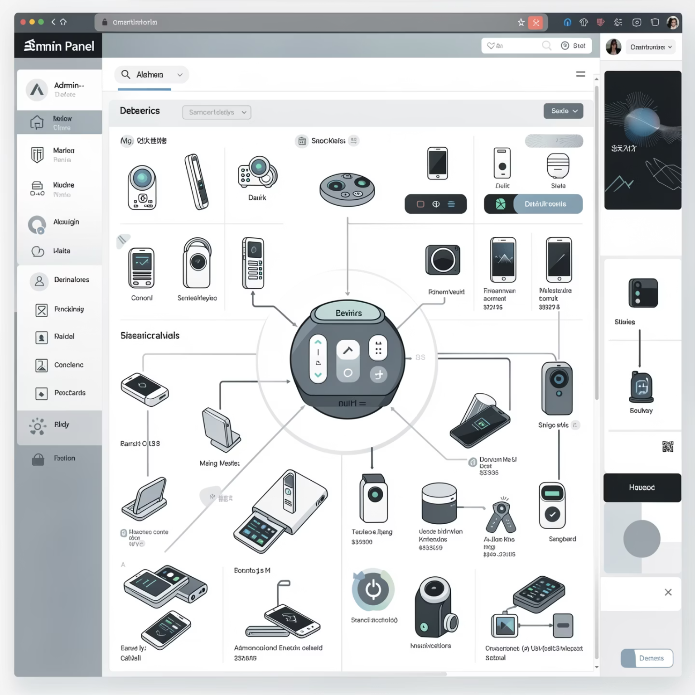

Administrator Device Control
Administrators have advanced access to maintain system stability:
View all devices: Complete oversight of the entire device network
Toggle any device: Ability to change the ON/OFF status of any connected device.
Delete any device: Authority to remove devices from the system as required.
These controls support system monitoring and maintenance.

Slide 10

Smarter homes, lower energy use, better control.
Thank you for your attention.
🤝

